Slide 1

Introduction: List and Array representations,
Operations on stack (traversal, push and pop)
Arithmetic expressions: polish notation, evaluation and transformation of expressions.

Slide 2

Introduction to Stacks
Consider a card game with a discard pile
  Discards always placed on the top of the pile
  Players may retrieve a card only from the top
We seek a way to represent and manipulate this in a computer program
This is a stack
What other examples can you think of that are modeled by a stack?

Slide 3
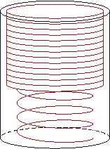
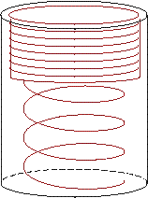
Introduction to Stacks
A stack is a last-in-first-out (LIFO) data structure
Adding an item
  Referred to as pushing it onto the stack
Removing an item
  Referred to as
  popping it from
  the stack

Slide 4
Stack
Definition:
  An ordered collection of data items
  Can be accessed at only one end (the top)
Operations:
  construct a stack (usually empty)
  check if it is empty
  Push: add an element to the top
  Top: retrieve the top element
  Pop: remove the top element

Slide 5
Stack
items[MAX-1]
. | .
. | .
. | .
items[2] | C
items[1] | B
items[0] | A
Top=2

Slide 6
Insert an item A
A new item (A) is inserted at the Top of the stack
items[MAX-1]
. | .
. | .
items[3]
items[2]
items[1]
items[0] | A | Top=0

Slide 7
Insert an item B
A new item (B) is inserted at the Top of the stack
items[MAX-1]
. | .
. | .
items[3]
items[2]
items[1] | B | Top=1
items[0] | A

Slide 8
Insert an item C
A new item (C) is inserted at the Top of the stack
items[MAX-1]
. | .
. | .
items[3]
items[2] | C | Top=2
items[1] | B
items[0] | A

Slide 9
Insert an item D
A new item (D) is inserted at the Top of the stack
items[MAX-1]
. | .
. | .
items[3] | D | Top=3
items[2] | C
items[1] | B
items[0] | A

Slide 10
Insert Operation(Array)
PUSH(STACK, N, TOP, ITEM)
If TOP=N:
write OVERFLOW, and Return.
2. Set TOP := TOP + 1.
3. Set STACK[TOP]:= ITEM.
4. Return.

Slide 11
Delete D
an item (D) is deleted from the Top of the stack
items[MAX-1]
. | .
. | .
items[3] | D
items[2] | C | Top=2
items[1] | B
items[0] | A

Slide 12
Delete C
an item (C) is deleted from the Top of the stack.
items[MAX-1]
. | .
. | .
items[3] | D
items[2] | C
items[1] | B | Top=1
items[0] | A

Slide 13
Delete B
an item (B) is deleted from the Top of the stack
items[MAX-1]
. | .
. | .
items[3] | D
items[2] | C
items[1] | B
items[0] | A | Top=0

Slide 14
Delete A
an item (A) is deleted from the Top of the stack.
items[MAX-1]
. | .
items[4]
items[3] | D
items[2] | C
items[1] | B
items[0] | A | Top=-1

Slide 15
Delete Operation(Array)
POP(STACK, N, TOP, ITEM)
If TOP = NULL then :
write: UNDERFLOW, and Return.
2. Set ITEM := STACK [TOP].
3. Set TOP := TOP - 1.
4. Return.

Slide 16
Insert Operation(LL)
Step 1: Allocate memory for the new node and name it as NEW_NODE
Step 2: SET NEW_NODE->DATA = VAL
Step 3: IF TOP = NULL
SET NEW_NODE->NEXT = NULL
SET TOP = NEW_NODE
ELSE
SET NEW_NODE->NEXT = TOP
SET TOP = NEW_NODE
[END OF IF]
Step 4: END

Slide 17
Delete Operation(LL)
POP(INFO, LINK, TOP, AVAIL, ITEM)
If TOP = NULL, then :
write UNDERFLOW, and Exit.
Set TEMP := TOP and Set ITEM :=INFO[TEMP]
TOP :=LINK[TOP]
LINK[TEMP] = AVAIL and AVAIL = TEMP
Exit

Slide 18
Postfix Notation(RPN)
Polish notation, also known as prefix notation.
It is a symbolic logic invented by Polish mathematician Jan Lukasiewicz in the 1920's.
Most compilers convert an expression in infix notation to postfix
  the operators are written after the operands
So a * b + c becomes a b * c +
Advantage:
  expressions can be written without parentheses

Slide 19
Postfix and Prefix Examples
INFIX POSTFIX PREFIX
A + B
A * B + C
A * (B + C)
A - (B - (C - D))
A - B - C - D
A B +
+ A B
A B * C +
+ * A B C
A B C + *
* A + B C
A B C D---
-A-B-C D
A B-C-D-
---A B C D
Prefix : Operators come before the operands

Slide 20

"By hand" (Underlining technique):
1. Scan the expression from left to right to find an operator.
2. Locate ("underline") the last two preceding operands
and combine them using this operator.
3. Repeat until the end of the expression is reached.
Example:
2 3 4 + 5 6 - - *
→ 2 3 4 + 5 6 - - *
→ 2 7 5 6 - - *
→ 2 7 5 6 - - *
→ 2 7 -1 - *
→ 2 7 -1 - * →
2 8 * →
16
2 8 * →

Slide 21
Evaluating RPN Expressions
P is an arithmetic expression in Postfix Notation.
Add a right parenthesis “)” at the end of P.
Scan P from left to right and Repeat Step 3 and 4 for each element of P until the sentinel “)” is encountered.
If an operand is encountered, put it on STACK.
If an operator @ is encountered, then:
(a) Remove the two top elements of STACK, where A is the top element and B is the next to top element.
(b) Evaluate B @ A.
(c) Place the result of (b) back on STACK.
[End of if structure.]
[End of step 2 Loop.]
Set VALUE equal to the top element on STACK.
Exit.

Slide 22
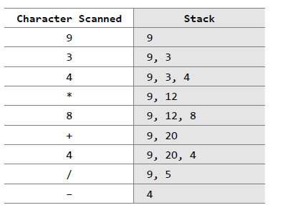
Evaluating
RPN
Expressions
Note the
changing
status of the
stack
infix expression
9 – ((3 * 4) + 8) / 4
Equivalent,
Postfix Notation
9 3 4 * 8 + 4 / –

Slide 23

By hand: "Fully parenthesize-move-erase" method:
1. Fully parenthesize the expression.
2. Replace each right parenthesis by the corresponding operator.
3. Erase all left parentheses.
Examples:
A * B + C →
((A * B) + C)
A * (B + C) →
(A * (B + C) )
→ ((A B * C +
→ A B * C +
→ (A (B C + *
→ A B C + *

Slide 24
Stack Algorithm
POLISH (Q, P)
PUSH “(” on to STACK and add “)” to the end of Q.
Scan Q from left to right and Repeat steps 3 to 6 for each element of Q until the STACK is empty:
If an operand is encountered, add it to P.
If a left parenthesis is encountered, push it onto STACK.
If an operator is encountered, then:
(a) Repeatedly POP from STACK and add to P each operator (On the TOP of STACK) which has the same precedence as or higher precedence than @.
(b) Add @ to STACK.
[End of If structure.]
If a right parenthesis is encountered, then:
(a) Repeatedly POP from STACK and add to P each operator (On the TOP of STACK.) until a left parenthesis is encountered.
(b) Remove the left parenthesis. [Don’t add the left parenthesis to P.]
[End of If Structure.]
[End of step 2 Loop.]
7. Exit.

Slide 25

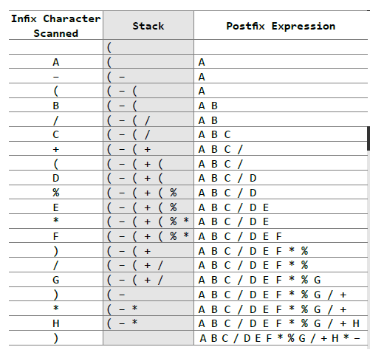

Slide 26

By hand: "Fully parenthesize-move-erase" method:
1. Fully parenthesize the expression.
2. Replace each left parenthesis by the corresponding operator.
3. Erase all right parentheses.
Examples:
A * B + C →
((A * B) + C)
A * (B + C) →
(A * (B + C))
→ + * A B) C)
→ + * A B C
→ * A + B C ))
→ * A + B C

Slide 27
Thank You

